Slide 1
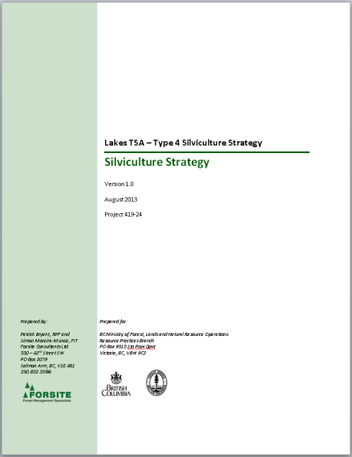
2013-14 FFT Fall Business Meeting
Integrating Type 4 Silviculture Strategies into FFT Planning
What the type 4’s are telling us?
Where they are taking us?
Paul Rehsler RPF
Resource Practices Branch

Slide 2

Project Overview
Help government and licensees better understand the current and future timber and habitat supply situation- and what can be done to improve it.
Recommendation 6.1d
“Complete a type 4 silviculture analysis for the Lakes TSA to guide the fertilization program and
also to set other important silvicultural goals as well as to support setting goals for the
management of wildfire risks in the TSA.”
Notes:
This project started with the 2009 SDP., where the main theme was the need for a MU Level Planning Framework. Numerous Board reports called for the same and for MU level goals and objectives; and more recently the AG’s Audit found a lack of clear management objectives for timber. And we started addressing these recommendations in the Type 4 Strategies.
We’ve also incorporated as much about other existing strategies as possible and any specific water related, range, habitat, and the type 4s point to, and include links to strategies and describe how climate change and the management of fire risk can be addressed through implementing the strategies.

Slide 3
Multiple Objectives
Realistic, forward-looking assessment of timber and habitat supply under a range of scenarios
  In-depth modeling
Products that support operational implementation
  Spatially explicit plan allowing for continual improvement
Provide context information or indicators
  Rationale for funding needs
Link with other plans and strategies
  Manage treatment risk
While it looks like a plan, it is a process – which is KEY
Notes:
Although a key objective is filling mid term timber supply, its not the only objective, also assessing habitat supply, and the impacts on range/forage, hydrology, wildlife, and fire risk.
We want to produce products that will support the implementation of the type 4s
The reports include indicators to show the impacts of the scenarios on other resource values.
And to rationalize funding requests.
There have been instances in most of the TSAs where after the completion of the modelling and analysis, there are issues indentified that could and should be revisited and possibly changed. There will always be new issues and hopefully better information to help address these issues. This is part of the SFM planning process. We need to keep challenging he assumptions and revising them when newer , better information becomes available.

Slide 4
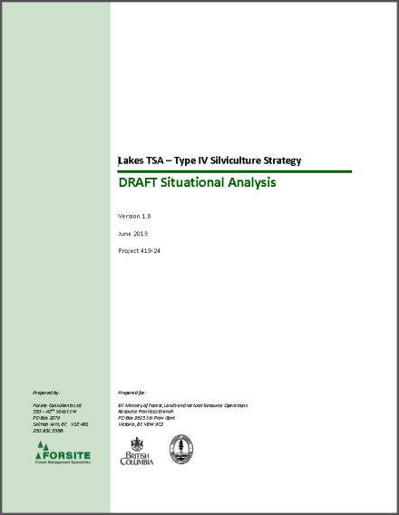
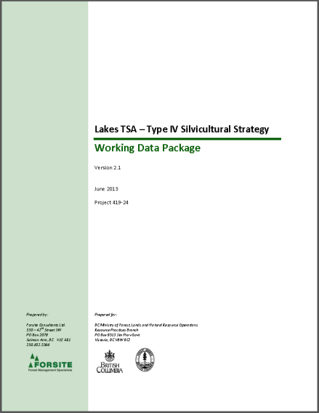
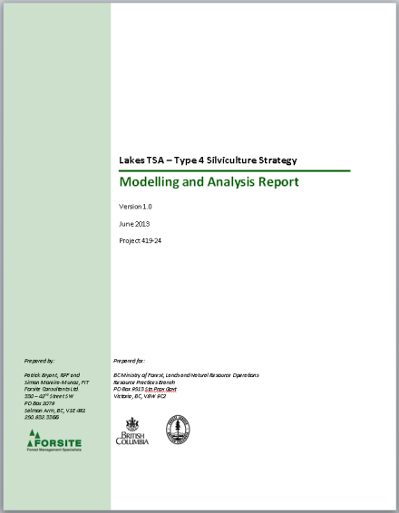
Deliverables
Situational Analysis
Data Package
Modeling and Analysis Report
Silviculture Strategy
Notes:
Sit Analysis – describes the general situation in the TSA
Data Package – describes the input data, information and assumptions.
The Base Case completes half of the modeling and analysis report which also describes the silviculture scenario modeling output and rationale for the preferred silviculture strategy
The Silviculture Strategy - provides direction for a TSA-level silviculture strategy considering input from stakeholders, experts, and the forest estate modelling

Slide 5
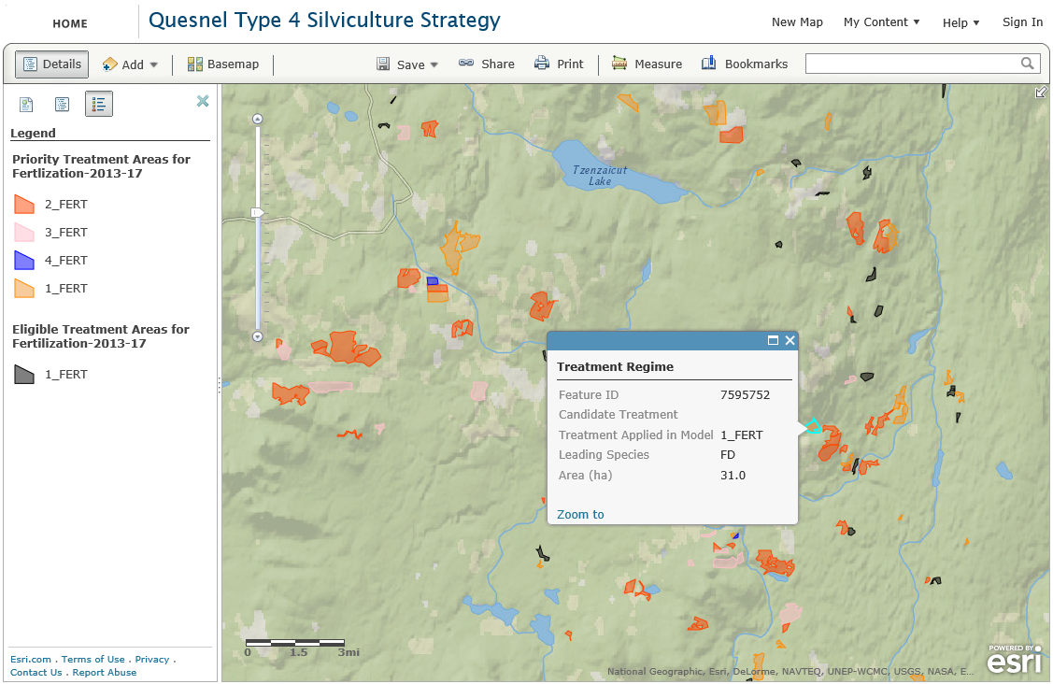
Deliverables
http://rpb.maps.arcgis.com/home/webmap/viewer.html?webmap=eb5020c4c131475fa155c6e446b1f54c
Notes:
The OK TSA project website included a mapping product to display the spatial outputs.
The Quesnel tactical plan was posted to an ArcServer – hosted by RPB. These were both practical means of sharing the deliverable.
This spatial outputs for the treatments include
Eligible Stands = Candidate blocks identified by model
AND
Priority Stands = Candidate blocks scheduled in the model.
Now the intent is not to blindly follow the models output and consider only these priority stands for treatments. There will be some “massaging” of the eligible and priority stands into the AOP.

Slide 6
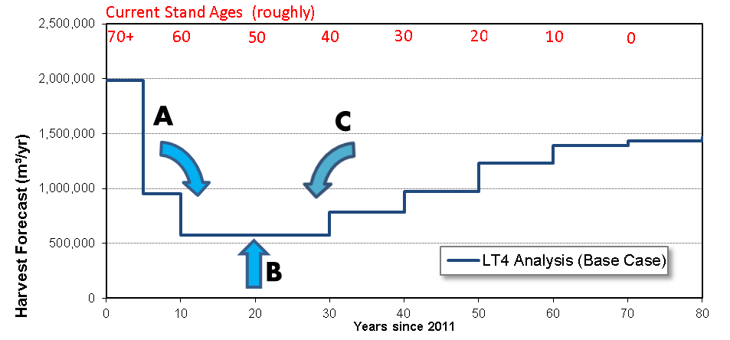
Strategies – Approach
Notes:
There a 3 opportunities to improve the mid term.
A - defer harvesting in the short term (eg avoid salvaging stands that have sufficient green volume)
B – increasing the yields of existing immature stands (40 -60 yrs) (single late rotation fert)
C – shifting available volume from the transition period by increasing the volume on young stands with current ages between 10-40 years old (CT, multiple ferts)

Slide 7
What the Type 4s are telling us?
What have we learned?
Changing harvest criteria has a significant impact on harvest flow and the mid term
  Minimum harvest criteria will impact flows as well as our future forest conditions and options
  Shelf-Life assumptions – are they being realized?
  Performance of MPB understory regeneration – do we have enough information to be confident?
  Geographical location and local conditions create different outcomes.
  Others
Notes:
Part of the Situational Analysis is identify issues in each of the TSAs.
There were similarities, and therefore we looked at standardizing the key assumptions that go into the model.
The where, what and how we harvest has a significant impact on harvest flow . Some of the harvest criteria that were examined are MHA, Shelf life, understorey regeneration, what stand types are being harvested and geographic location.
Others include
- cable vs traditional grounds, in some TSA an increasing portion of the harvesting will be cable – but this will increase costs;

Slide 8
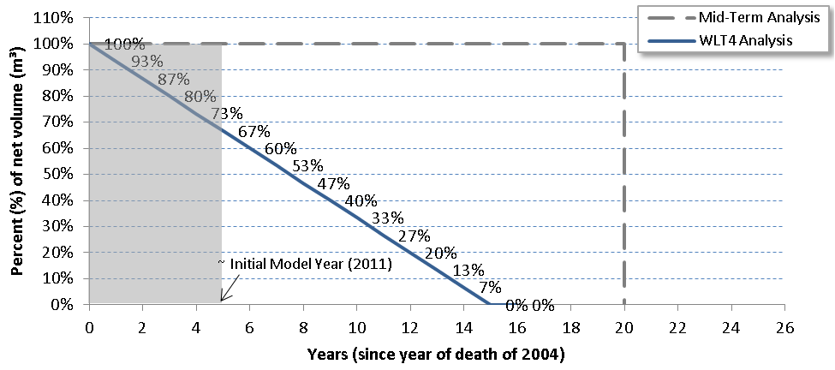
Key Assumptions – Shelf Life
Notes:
TSR / Mid Term Analysis assumed all dead pine was merch for 20 years (this will vary by TSA), from when it was killed, then completely removed
Combined with the min vol per ha this allows significantly more MPB-impacted stands to be salvaged in the Midterm Analysis – leading to more short term volume and more long term landbase in active timber production.
In contrast, the T4 analysis assumed a declining, straight-line shelf life curve to depict pine degeneration eg 50% available at year=7.5, and 0% available at year=15).
The model ( for WL) started at year=5 (calendar year=2011) along the shelf-life curve for many stands, which meant that 33% of the MPB-killed volume was already non-merchantable, while the Mid-Term Analysis assumed all this volume was fully available.
The trend continues once modelling begins as volume continues to fall away in the current model while the Midterm Analysis continues to have access to all of the dead pine volume.
Four key assumptions related to MPB Impacts:
Mortality (percent and YOD) from VRI (estimated based on overview flights and BC MPB model)
Note: used to calculate yields for remaining live overstory (All stands >=60yrs)
Shelf life
Understory regeneration
Young pine mortality
Shelf life assumes:
Applied to stands >=60 yrs old with >=60% mortality
Only 52% of the attacked pine volume (merch) is available at the start of the model (YOD 2004).
No attacked pine volume is available after 2021 (YOD 2007)

Slide 9
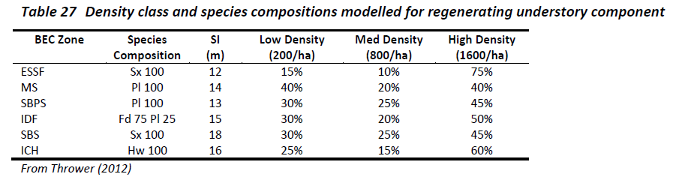
Key Assumptions – Understory Regeneration
Only the MPB kill classes “60-79%” and “80-100%” have understory as per the table above.
Notes:
Understory regeneration assumptions:
Applied to stands >=60 yrs old with >=60% mortality
Density classes were assigned randomly (results in a few weird-looking curves)
Yields are considerably reduced from typical even-aged regeneration assumptions for the same site- clumpiness and OAFs
Imperfect
Based on work by Coates and Sachs; with input from Jim Thrower (G&Y Expert)

Slide 10
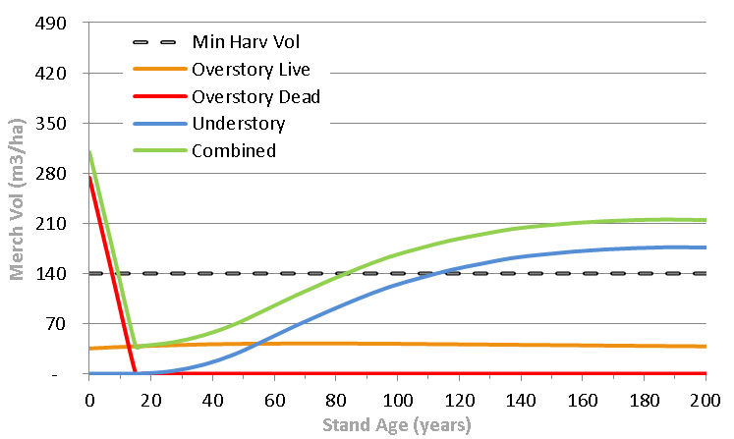
Key Assumptions – MPB Dynamics
Different combinations of overstory live & dead and understory will impact the length of time available for salvage, unavailable and available again
Unavailable
Richmond BC
Notes:
When Combining the shelf life assumptions with understorey yield curves ; there will be a period before the dead pine reaches it shelf life that is available.
Then as the understory grows and its combined with the live overstorey. It become available for harvest again after reaching the min volume, in this case 140m3/ha.
The goal would be to salvage as much as possible before it becomes unavailable. And also consider the amount of live overstorey as harvesting this in the mid term will contribute.

Slide 11
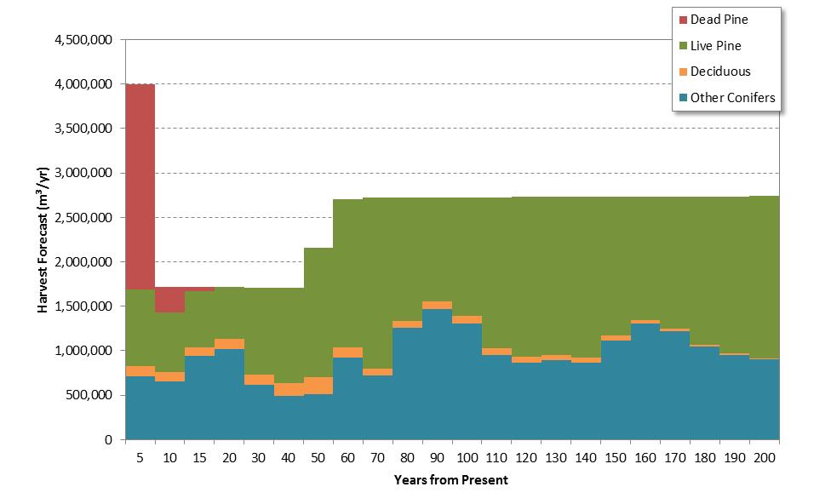
Harvest Flow
Harvest Volume by Stand Type in Quesnel TSA
Dead Pl Vol Salvaged = 26.8M (71% of time 0)
Notes:
In Quesnel, and the other MPB Impacted TSAs, harvesting in the first decade is concentrated on dead pine.
71% of the dead volume is salvaged in the model in the first 2 decades.
Most of green volume coming out in conjunction with salvage of Pl (bycatch)
Important messages
Amount of dead pine that gets harvested is based on the shelf life assumptions
If this is incorrect, and/or more live pine and other species are harvested than the 1.6M shown in the first 5 years, this volume would not be available in the mid term

Slide 12
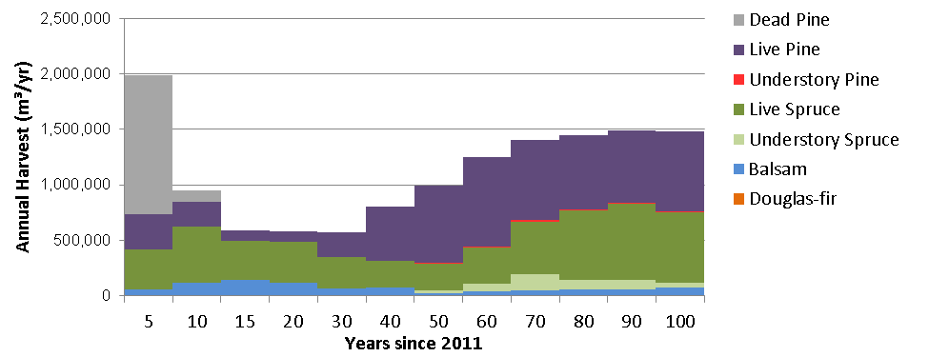
Harvest Flow
Harvest Volume by Stand Type in Lakes TSA
In first 5-yr period (2011-2015),
79% of the harvest volume is pine (63% dead; 16% live),
with spruce/ balsam comprising the rest.
Notes:
IN LAKES
Figure shows the harvest forecast again themed by individual species and condition (dead or alive)
Within the first 5-year period (2011-2015), 79% of the harvest volume is pine (63% dead; 16% live), with spruce and balsam comprising the rest.
The harvest of non-pine species increases to 77% throughout the mid-term, reflecting a sharp decline in merchantable pine.
In the long-term, a more even harvest pattern develops of 54% pine and 46% non-pine species.
Like Quesnel and other TSAs, the shelf life will affect the amount of dead pine salvage and harvesting less that the 63% dead and more live pine, spruce and balsam will impact the mid term. And lead to a quicker transition from natural to managed stands

Slide 13
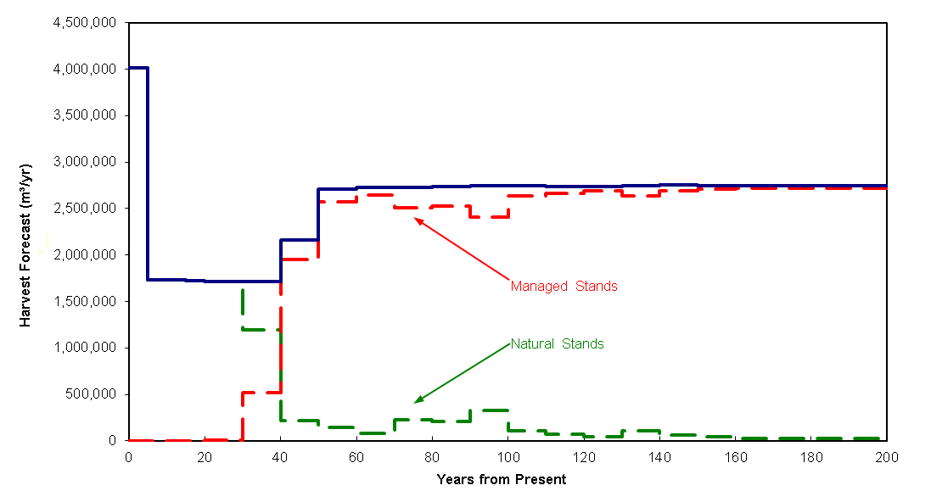
Harvest Flow
In Quesnel, harvest of managed stands starts in 30-40yrs, dominant by 40-50 yrs.
Notes:
The timing to this transition will vary by TSA, in Quesnel TSA, IF HARVESTING FOLLOWS THE MODEL ASSUMPTIONS AND OUTPUTS the harvesting of managed stands starts in the 3rd decade. And dominants the harvest profile by the 4th decade.

Slide 14
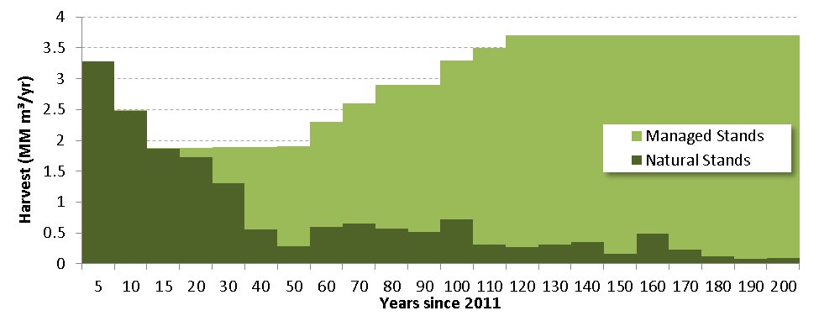
Harvest Flow
In Williams Lake, harvest of managed stands starts sooner, year 16-20, dominant by year 30.
Notes:
In Williams Lake the transition is much sooner, NOTE FIRST 20 YEARS in 5 YEAR INTERRVALS
Here, harvesting managed stands begin sin year 16 and is dominant by year 30.

Slide 15
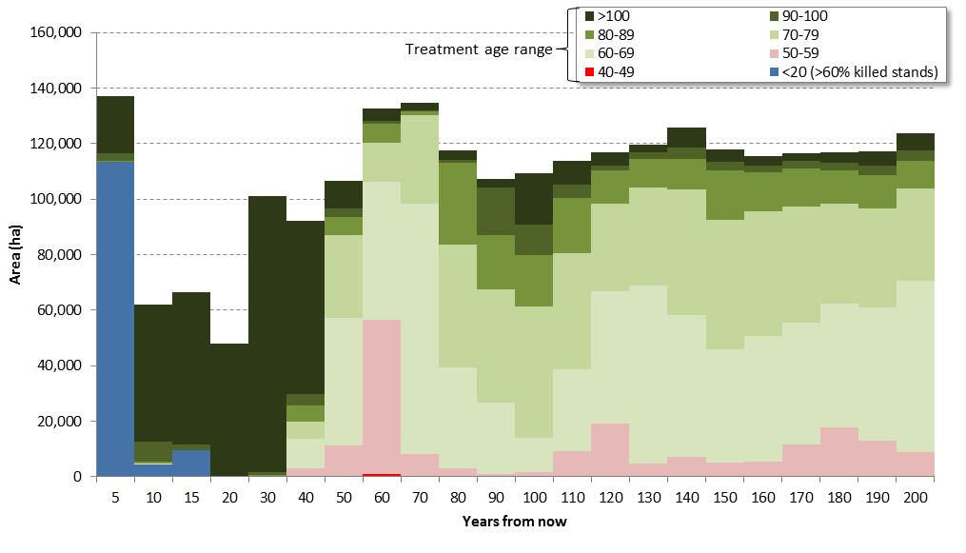
Harvest Ages
In Quesnel, 45% of area harvested will be stands < 60 years old in the mid term
Notes:
As you’d expect, when transitioning to managed stands, the harvest ages will decrease, as shown by the dark blue/green in the earlier decades becoming the lighter green and pink/red. In the mid term, 45% of stands in the Quesnel will be < 60 years old.
This percentage will increase and stands will, on average, be even younger or the mid term timber supply will be reduced if there is less salvage and more green volume harvested in the near term.

Slide 16
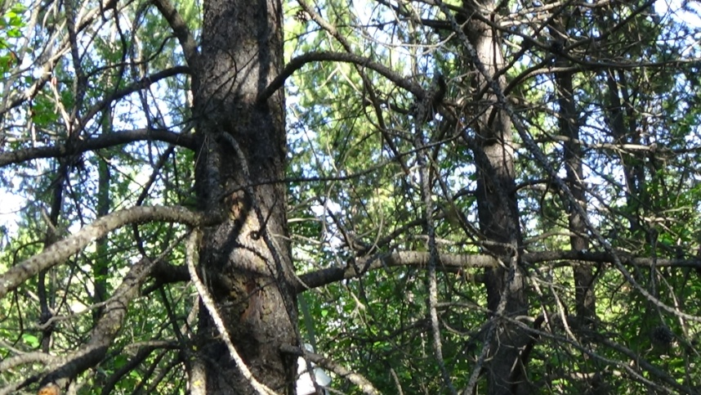
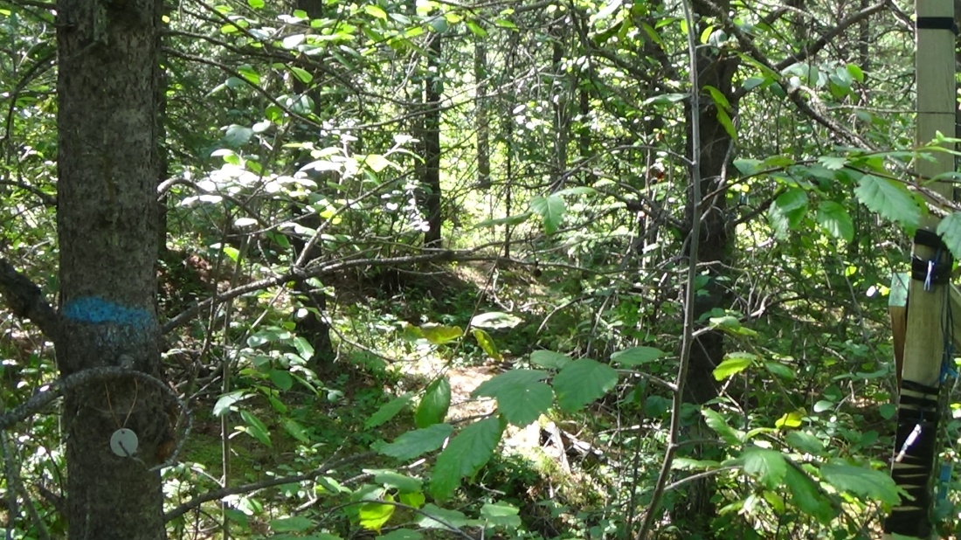
Harvest Ages
The question from the Type 4’s is
What will these stands produce in the time frames identified?
Will our stands produce what we expect?
A key element of the Type 4 is identifying what more we need to know to better manage our expectations.
Notes:
This percentage will increase and stands will, on average, be even younger or the mid term timber supply will be reduced if there is less salvage and more green volume harvested in the near term.

Slide 17
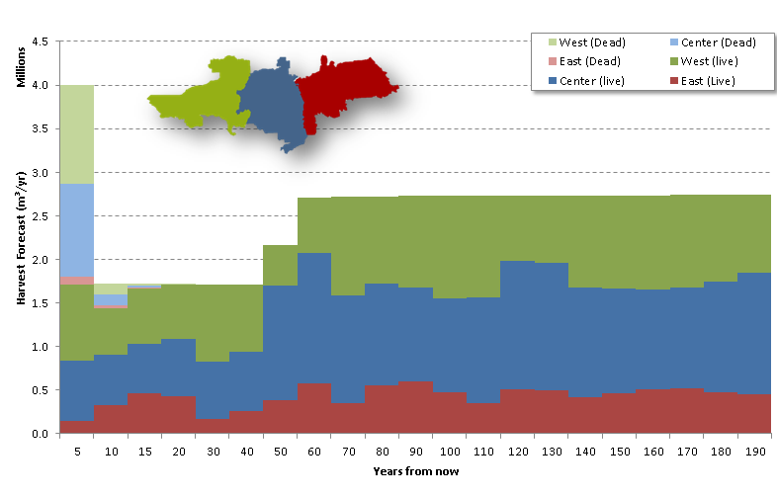
Harvest Flow
By Geographic Area in the Quesnel TSA
  First 5 yrs: 50% from West, 6% from East
Notes:
Another important assumptions is where the harvesting is occurring.
In Quesnel, in the first 5 years, the model harvests 50% from the west;
This percentage decreases in the mid term

Slide 18
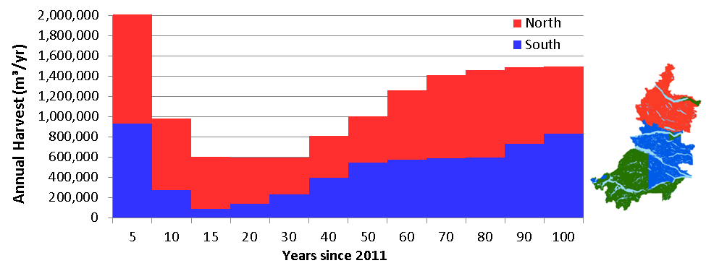
Harvest Flow
by Geographic Area in the Lakes TSA
74% of harvest is scheduled from the Northern LRMP Region in the mid term
18
Notes:
Similarly in the Lakes TSA, where 74% of the harvest is scheduled form the northern parts of the TSA

Slide 19
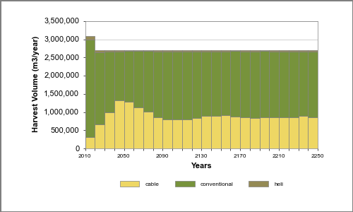
Harvest volume by harvest method in the Okanagan TSA
49% cable harvesting in decade 4,
Stepped up approach to facilitate transition
Is this realistic?
Notes:
Another key harvest assumption , this example from the Okanagan TSA, is the amount of harvest from cable vs conventional ground based harvesting
The harvest scenario that maximized the mid term flow, showed a sharp increase in cable; however, this was considered unrealistic by the district type 4 group; therefore a stepped up approach was used.

Slide 20
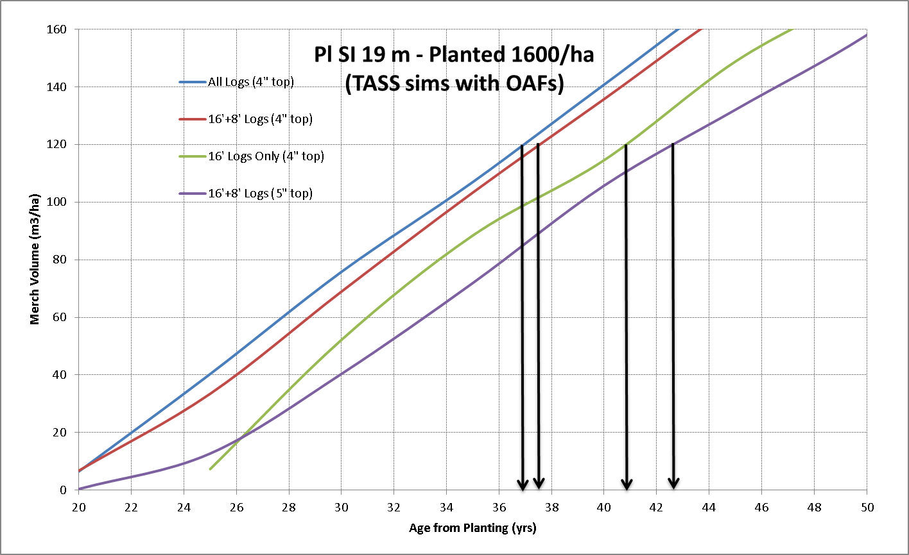
MHA's & Products
Notes:
The graph shows different MHA’s given different desired products;
You need to hold these pine stands longer in order to harvest higher quality sawlogs

Slide 21
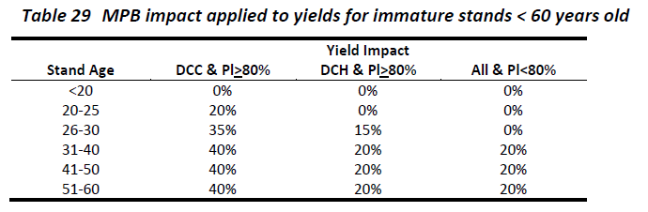
Key Assumptions – Young Pine Mortality
Richmond BC
Notes:
Another key assumption, but not related directly to harvesting is the young pine mortality that is
Applied to stands <60 yrs old
Both natural and existing managed stands

Slide 22
Silviculture Treatments
Enhanced basic silviculture
Fertilization – single and multiple application
Pre Commercial Thinning w/wo fertilization
Rehabilitation
Partial cutting in constrained areas
Composite mix of the strategies
Richmond BC
Notes:
Here’s a list of the treatments that are being considered in the Type 4s that are underway.
READ THEM
Enhanced basic silviculture
Fertilization – single and multiple application
Pre Commercial Thinning w/wo fertilization
Rehabilitation
Partial cutting in constrained areas
Composite mix of the strategies

Slide 23
Strategy – Enhanced Basic Reforestation
Purpose
  Enhancing basic reforestation practices where current performance is not optimal (achieving minimum well-spaced trees/ha versus target well-spaced trees/ha).
Benefits
  Increase initial well-spaced stand densities and reduce stocking gaps
  Expected to increase timber volume and quality
  May benefit the back end of the midterm trough
Notes:
The enhanced basic strategy was suggested in Quesnel and Williams Lake TSAs.
By increasing initial stocking levels, there is an expected increase the volume and value which may benefit the mid term timber supply in the back end of the trough

Slide 24
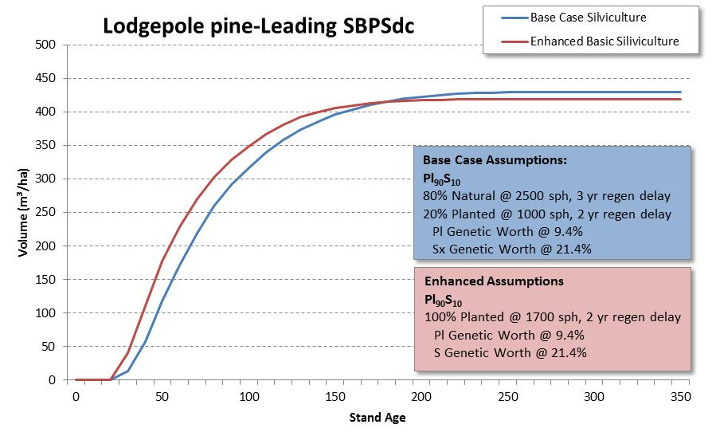
Enhanced Basic Silviculture
Stand Level Examples
Notes:
Here’s a stand level example of the enhanced basic
Where at harvest ages of 60 years, the volume per hectare increases from 200 to 250m3/ha .

Slide 25
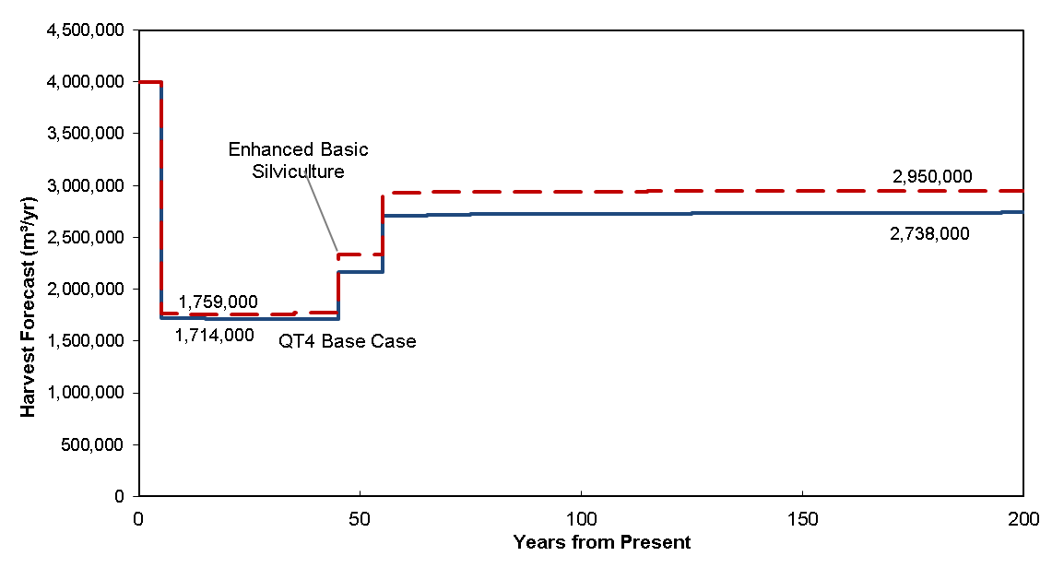
Enhanced Basic Silviculture
+45,000 m³ in midterm + faster rise, 212,000 m³/yr in long-term
Notes:
Although enhanced basic was selected as strategy by the TSA Groups, without a mechanism to fully implement it on the entire TSA and not just the FFT / govt funded work, these gains - 45,000 m3 in the mid term - wont be achieved.

Slide 26
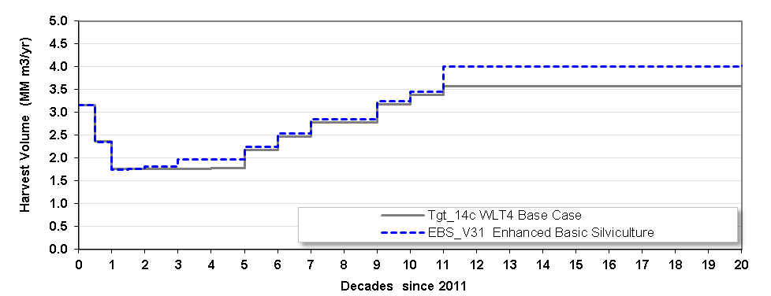
Strategy: Enhanced Basic Reforestation
Short (~)
Mid (+5%)
Rise (+2%)
Long (+12%)
First stands are ready in 35-45 years as
min harvest volumes are reached sooner.
Mid and long term benefit from enhanced
yields. Little to no ACE effect.
Notes:
In Williams Lake, the enhanced basic strategy provided a
5% increase in the Mid term and12% increase in the long term
This is because of the
Improved densities/stocking;
shorter regen delay;
Use of Class A seed;
reduced min harvest ages;

Slide 27
Strategies – Rehabilitate MPB-Stands
  Rehab MPB impacted stands with little or no salvage opportunity.
  Expect to increase late mid-term harvest levels.
  Recover some merch (green) volume in mid-term
  The long-term harvest levels significantly improved with regeneration for managed stands.
    Improved OAFs, lower regeneration delay and select seed
    Higher yields and min harvest volumes sooner
Notes:
The next strategy, rehabilitation of MPB stands that have no salvage opportunity (ie the volume is below the min operability levels; is expected to provide an increase in late mid term harvest an also some immediate recover of any green volume
Long term harvest levels will be significantly improved

Slide 28
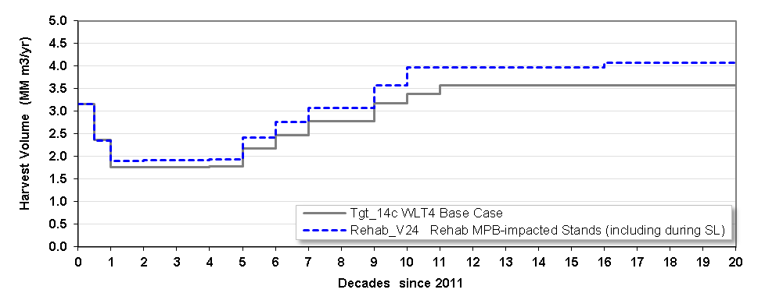
Strategy: Rehabilitation
Short (~)
Mid (+8%) - volume at time of treatment + some THLB back in
Rise (+13%) – Non merch stands brought back into production
Long (+13%) – Non merch stands brought back into production
Notes:
The response from stands transitioning onto future managed stand yields, converting natural stands into high-producing managed stands, effectively increases the productivity of the land base by accessing stands that were left unharvested in the base case.
With some Incidental harvest of remaining green timber in the mid term

Slide 29
Strategies – CT / PC Constrained Areas
Commercial Thinning / Partial Cutting of Constrained Areas
  A single removal of 1/3 of the volume
  Stands currently constrained for visuals, lakeshore management, mature-plus-old seral and watershed ECA requirements.
  Expect to increase the mid-term harvest level by offering some volume during periods of low volume availability.
  Maintain stand conditions to satisfy the non-timber values.
Notes:
Another strategy is partial cutting or CT in constrained areas. By entering these stands during the mid term and removing 1/3 the volume, there is an immediate increase while maintaining condition that satisfy the other values

Slide 30
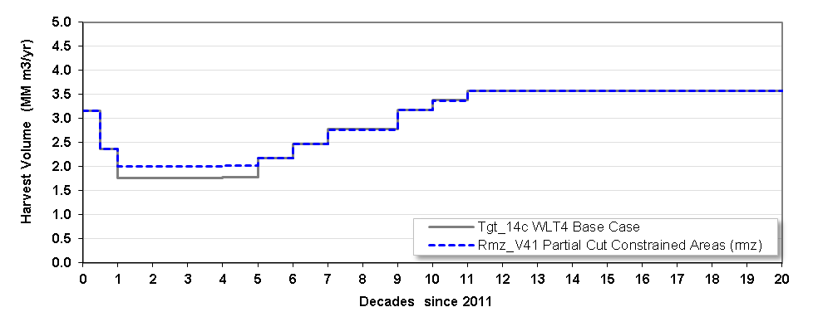
Strategy: Partial Cut in Constrained Areas
Short (~)
Mid (+14)
Rise (no attempt to improve)
Long (no attempt to improve)
Significant improvement
in midterm due to accessing
stands that would otherwise not
be available.
Notes:
In Williams Lake TSA as shown there is a significant improvement in the mid term – 14% - due to accessing stands that would otherwise not be available

Slide 31
Strategies – Spacing Dry-belt Fd
Response
  Initial entry harvest volume (shelterwood and selection) increased by 10% for stands treated at least 30 years prior to harvest

Slide 32
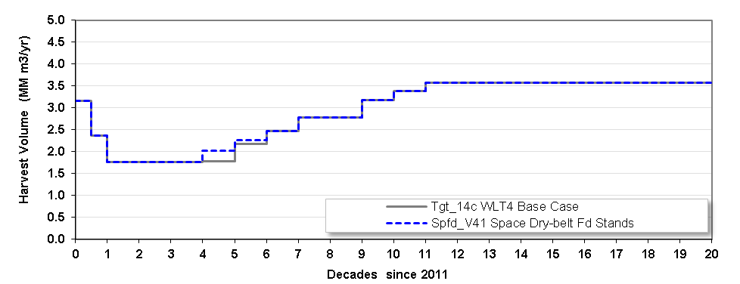
Strategy: Spacing Dry-Belt Fd
Mid (+3%)
Rise (+1%)
Delayed response as have to
wait 30 yrs after treatment to
harvest.
Notes:
Dry belt Fd makes up a large portion of the 100 Mile House, WL and Okanagan TSA s
Many of these stands will benefit from of pre harvest entry / treatment
Thinning young thickets in NonUWR stands
A small increase to the mid term in the WL TSA is shown

Slide 33
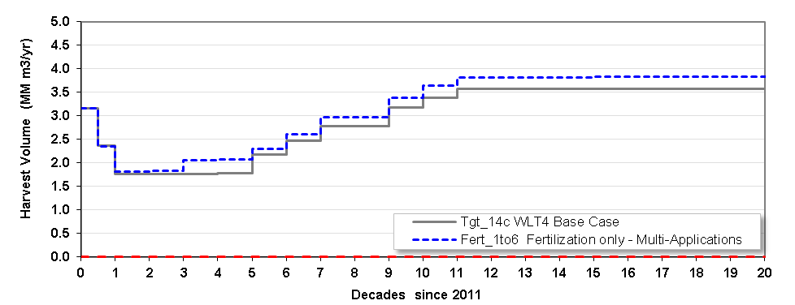
Strategy: Fertilization
Short (~)
Mid (0-10
Rise (+5%)
Long (+8%)
Notes:
For fertilization treatments,
There will be a slight bump near the end of the mid term;
Harvesting through the mid-term harvest pinch is weighted higher than bumping volumes slightly and delaying harvest for 10 years
In the Rise, the increased opportunities to treat stands beginning in 20+ years
this continues to build and in the Long-term there is a full set of opportunities
There was little difference between single- and multi-fert;

Slide 34
Strategies – PCT and Fertilize Pl Stands
Pre-commercial Thinning / Cleaning Dense Pine & Fertilization
    improve stand quality/health/resilience through leave tree selection, increase stand volumes through fertilization and advance operability in these stands.
  Eligible stands:
    Pl-leading; 10-20 years old (typically 6,000-20,000 sph)
    Thin to target density of ~2,500 sph; Fertilize
Notes:
This strategy combines PCT with fertilization,
By improving stand quality/health/resilience through leave tree selection first,
And then increasing stand volumes through fertilization
It advances operability in these stands.
Eligible stands are high density young pine stands
(Pl-leading; 10-20 years old typically 6,000-20,000 sph)

Slide 35
Strategy – Optimal Mix of Treatments
Include all treatments
Best mix of treatments and timing
Subject to annual budgets:
  Constrained $2,000,000 - $3,000,000
  Preferred $5,000,000 - $7,000,000
Notes:
The final strategy, is the optimal mix of all the treatments
We asked each TSA team what budget levels are appropriate
A Pie-in-the-sky and Realistic figure
The OK TSA didn’t have an assigned budget, and the model selected treatments with a
total annual budget ranging from $2.6 – 6.1M / year with an average of 3.8M/year.

Slide 36
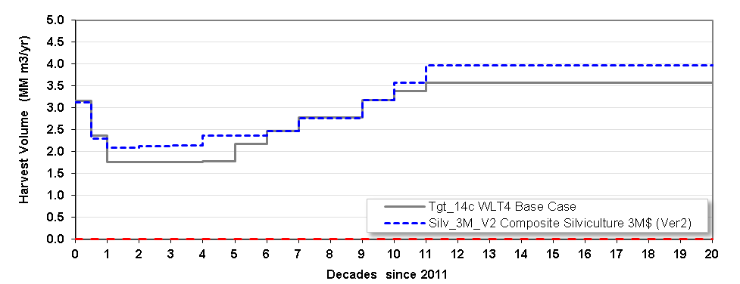
Optimized Mix – $3 Million/yr Budget in the Williams Lake TSA
Short (~)
Mid (+22%)
Rise (+2%)
Long (+11%)
Midterm increased as priority over
longterm.
Notes:
The optimal mix with a $3M budget generated 22% more volume in the mid term, 2% more in the rise and 11% in the long term in the Williams Lake TSA.
Treatments were selected with increasing mid term as a priority over the long term.

Slide 37
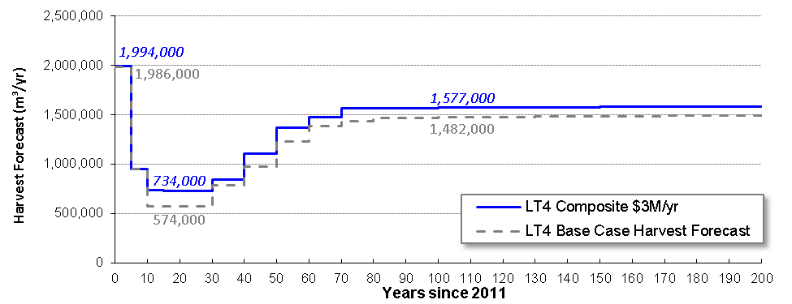
Optimal Mix – $3 Million/yr Budget in the Lakes TSA
Short (~)
Mid (+28%)
Rise (+10%)
Long (+6%)
Mid: Significant gains from rehab (green) and some fert
Rise: Early rehab converts natural stands to high-producing managed stands
Long: Increases landbase (stands otherwise unharvested)
Notes:
In Lakes, the mix of treatment at the $3M a year level, resulted in a 28% rise in the midterm, 10% in the rise and 6% in the long term.
With much of this gain attributed to rehab and some to fertilization.

Slide 38
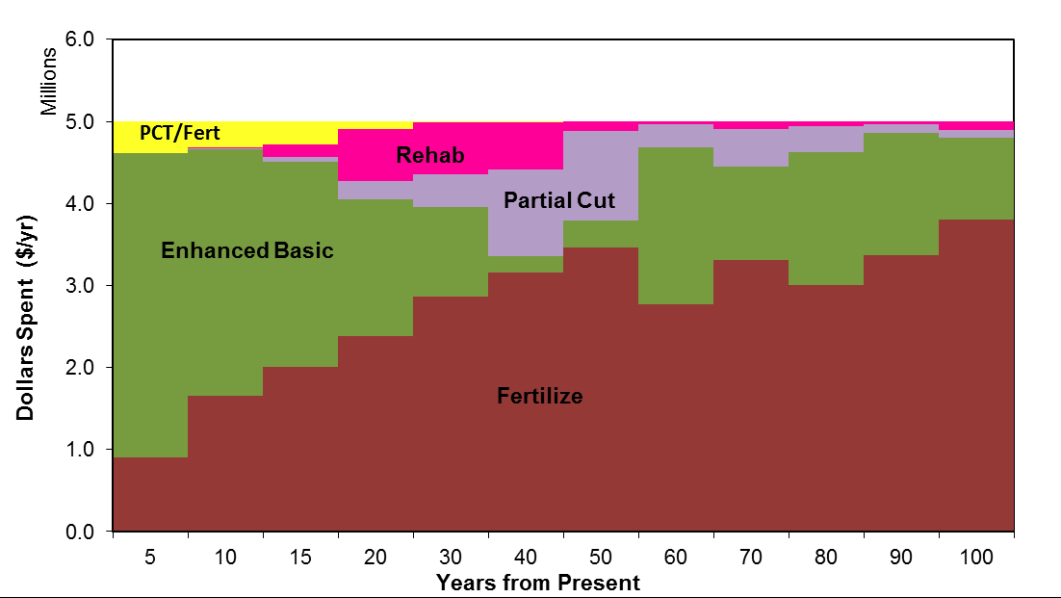
Preferred silviculture strategy in the Quesnel TSA
Richmond BC
Notes:
Adapting outputs from the strategic plan into a tactical plan requires interpretation of the learning achieved from the individually modelled silviculture scenarios, as well as, an understanding of the modelling assumptions and limitations.
Looking at the model output of the preferred silviculture strategy in Quesnel
A modelling artifact prevented the model from implementing the rehabilitation strategy sooner;
MPB impacted stands first need to undergo the transition to a post-shelf life stands before they are eligible for rehabilitation
Rehabilitation may also be delayed because although relatively little volume is harvested from this treatment type, the volume that is captured still contributes to improving the mid-term harvest level when merchantable timber volume is scarce.

Slide 39
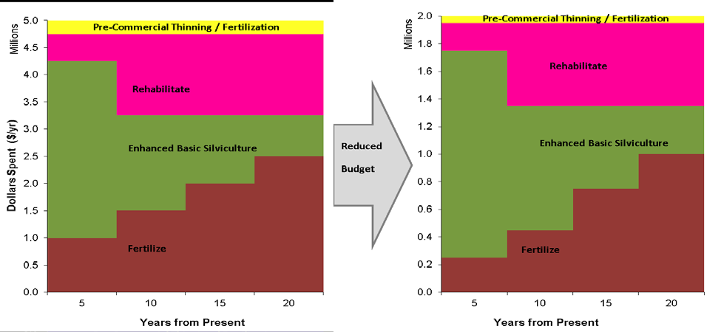
Silviculture expenditure levels used to inform the tactical plan
Richmond BC
Notes:
Figure shows the silviculture expenditures levels used to inform the tactical plan for the next 20 years.
$5M on the left and $2M on the right were the 2 funding levels used in Quesnel.

Slide 40
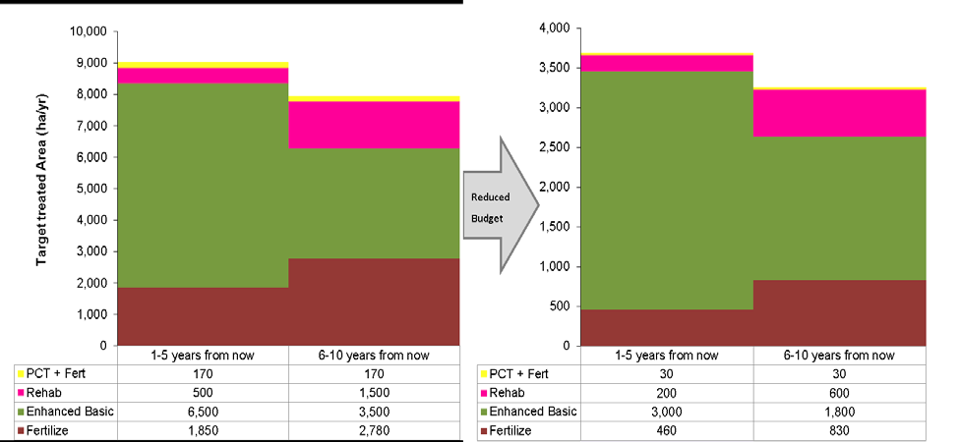
Target treatment area for the Tactical Plan
The silviculture expenditures levels used to inform the tactical plan for the next 20 years.
Richmond BC
Notes:
This shows the silviculture expenditures levels used to inform the tactical plan for the next 20 years.
What is the right balance of treatments? In Quesnel
The model favoured the enhanced basic treatment in the near term
This is due, in part, to the lack of candidate stands for other treatments such as fertilization and rehabilitation, but also because it delivers volume into the back end of the midterm.
In addition to the timber supply benefits, the higher density stands with this activity could result in timber quality improvements such as lower knot sizes, reduced risks from damaging agents and climate change, and provide options for further stand management.
If budgets are more constrained (e.g., $2 Million/yr), pre-commercial thinning and fertilization are reduced at the expense of enhanced regeneration, while rehab remains similar.
Fertilizing should still be considered an important element of this strategy due to its more immediate impact and therefore reduced risk of loss (fewer years of exposure to natural disturbance). Overall though, a diverse mix of investments will help to minimize these potential losses.

Slide 41
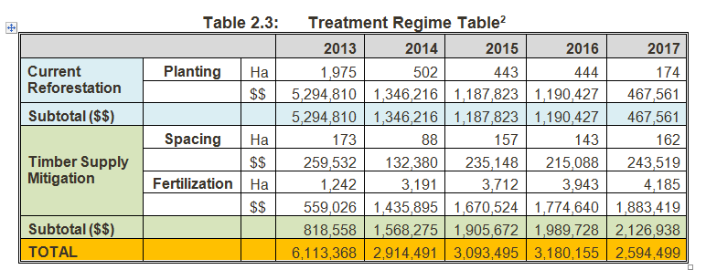
Okanagan TSA Treatment Regime
Does not reflect all activities carried out in the TSA
Includes only those activities modelled by this analysis.
Where are the treatment areas?
Richmond BC
Notes:
In the Okanagan TSA, where the budget was not constrained, the model selected treatment that would address the pinch points where timber would be most limited.
By fertilizing to mitigate the shortage around 2025 and a series of treatments to address the 2060 shortage

Slide 42
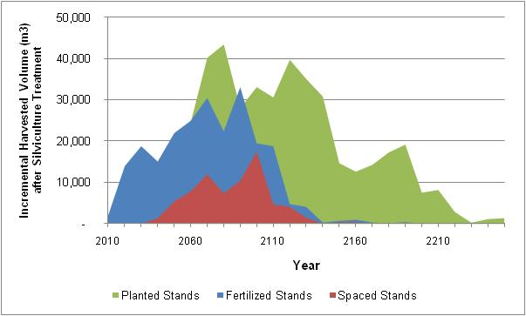
Timing and volume of harvest for stands treated in the Okanagan TSA
Additional volume at 2025 and 2060 pinch points
A new tool called “NSR Integrated Knowledge Engine” will be used for Integrated Decision Making / Authorizations
Notes:
The figure shows the timing and the volume of harvest for the stands treated in the silviculture program
The fertilization program made volume available for the first pinch point 2025, whereas all three activities made extra volume available in the mid term pinch point 2060

Slide 43
Tactical Plans
The spatial location of both eligible and priority stands is a key component of the tactical plan
Eligible vs priority will give insight into types of stands prioritized for treatment
Richmond BC
Notes:
Tactical plans in these Type 4s is the process of giving direction to translate to translate the preferred silviculture strategy into reality.
It is made up largely of direction from the analysis and the spatially explicit mapping layers.
The spatial location of both eligible and priority stands is a key component of the tactical plan

Slide 44
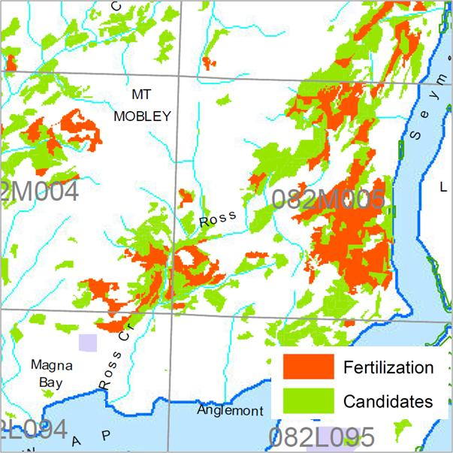
Fertilization Treatment Map
The model chose:
Higher proportion of Spruce over Douglas fir and pine
Heavily in the 30 – 50 yr old
More wet belt ecosystems
Fertilization
Eligible Area (ha) | 61,316
Treated Area (ha) | 16,274
Treated % | 27%
$million total (over 5 years) | 7.32
$million per year for 5 years | 1.46
Richmond BC
Notes:
Using fertilzation in the OK TSA as an example,
Eligible stands are the total pool that is available to choose from when implementing the fertilization treatments.
Summaries of eligible vs priority stands, can give further insight into the types of stands prioritized for treatment and hence provided further direction.
For fertilization, these general silviculture trends include:
The model chose to fertilize a higher proportion of spruce and less Douglas-fir and pine;
Although ages from 15 years through 80 years were eligible for fertilization, the model chose to fertilize 73% in the 30 to 50 year age range; and
The model chose to fertilize proportionally more area in wet belt ecosystems.

Slide 45
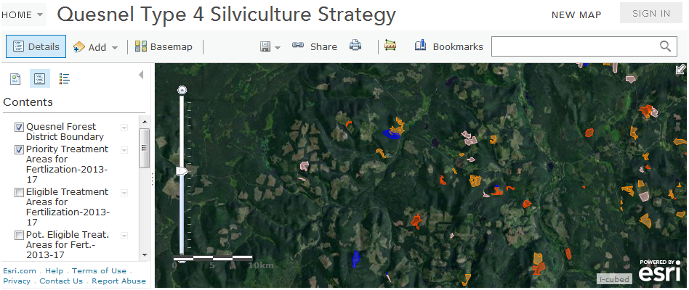
Spatial Outputs
Static maps
ArcGIS Online
ArcGIS for Desktop
Richmond BC
Notes:
One of the project objectives, and deliverable from the Type 4s is a spatially explicit tactical plan
Matt, Al and district staff have worked with together to produce treatment opportunity maps. The data behind these maps comes largely from RESULTS and other layers in the LRDW.
The output from the Type 4s is being shared by posting it to an on line webmapping platform ArcGIS Online
But manipulating the priority and candidate treatment areas into an AOP may require the desktop version of ArcGIS.

Slide 46
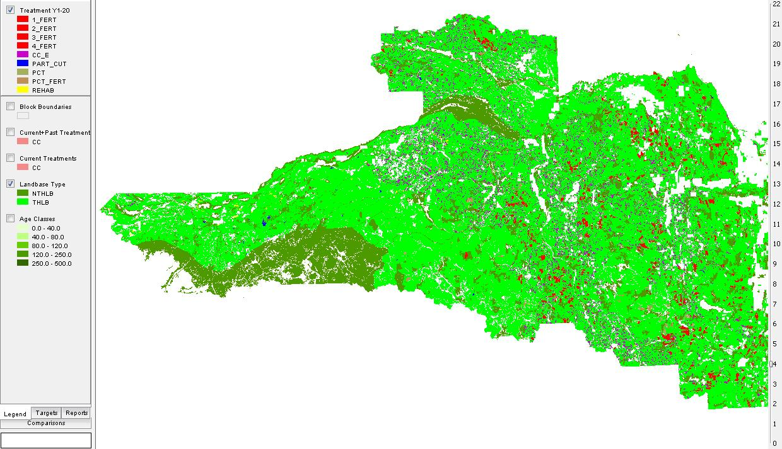
Optimized Scenario
Activity Years 1-20
Notes:
Here’s an example of the Preferred or Optimized Scenario for Quesnel, showing ALL the activities the model selected for the period – 1-20 years.
This now needs to be presented, reviewed, massaged and put back together as the FFT AOP.

Slide 47
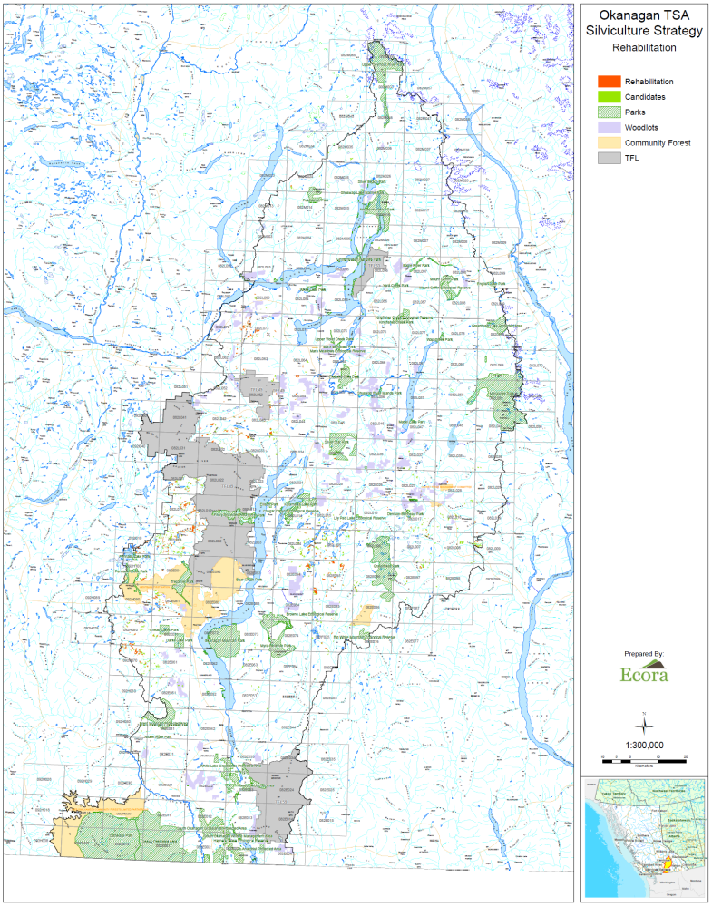
Static maps
For reports or
wall maps for displays
Shows overall
opportunities
General location of
treatments areas

Slide 48
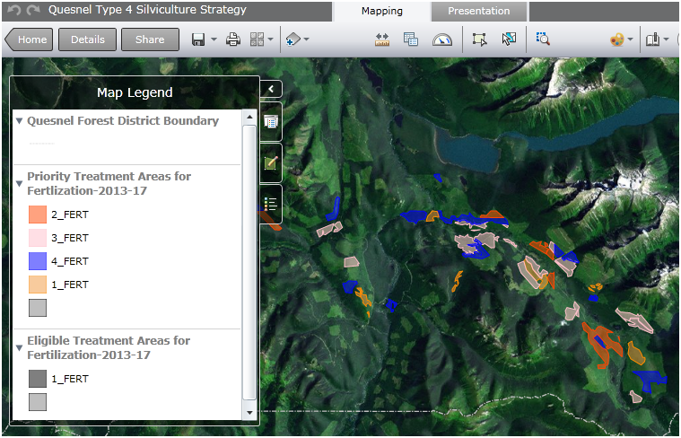
ArcGIS Online
Richmond BC
Notes:
This is a tool that may be made available ministry – wide through IMB
RPB currently hosts its own version.
Its good for sharing the spatial data, some tools are available with this product.
But Is it enough?

Slide 49
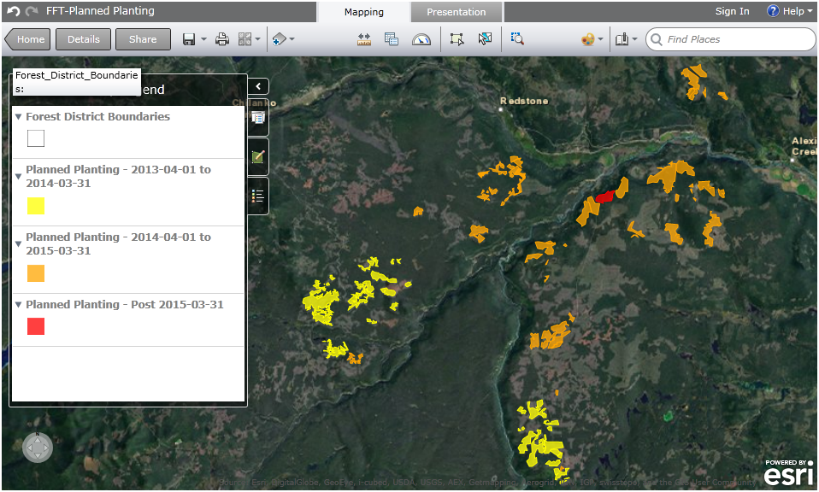
FFT Program Maps
Notes:
Another example of the Arc GIS product showing a 3-year Operational Plan.

Slide 50
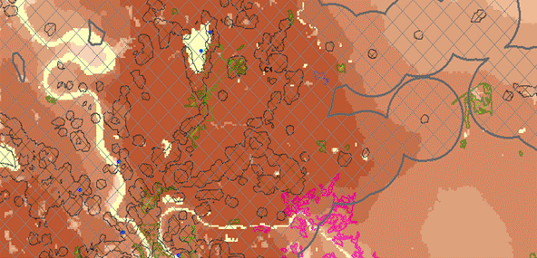
Spatial overlays
Prioritize silviculture treatments considering wildfire manegemnt
Burn probability, interface areas and candidate treatment area
Fertilization in high burn probability inside a WUI
Fertilization in moderate burn probability outside a WUI
Spacing / cleaning in high burn probability inside a WUI
Notes:
But in order to perform spatial overlays and show the silviculture treatments in relation to other strategies, may require ArcGIS for Desktop and the assistance of your district GIS staff.
I know that Brad Powell in Quesnel, who is not here today, is doing this right now.
And like the FFT planting program map in the previous slide, the spatial plan can then be loaded back onto ArcGIS online for others to view.
Matt will be going over this again in more detail this afternoon / tomorrow

Slide 51
Range – Forage Supply in the Okanagan TSA
Forage supply analysis, to allow range to be considered
Changes in forage supply are influenced by implementation of ‘range cut blocks”
Type 1 Forage Cutblocks – moderately increase forage opportunities with standard tree stocking
Type 2 Forage Cutblocks – enhanced forage opportunities with standard tree stocking
Type 3 Silvo-pasture Cutblocks – high forage production, with 50% - 100% (75% average) of timber production at rotation
Type 4 Forage Pasture Cutblocks – converted to permanent forage production
Richmond BC
Notes:
One of the objectives of the Type 4s is to link to other strategies. Range and forage production in the OK TSA is good example
In the Forage Strategy for the Okanagan Shuswap District, assumed forage growth is dependant on how cutblocks are harvested, and characterized by Cutblock types 0-4
Range licenses have been issued throughout the OK TSA, which are affected significantly by harvest activity…
The OK TSA Type 4 Silv Strategy has a range supply analysis that shows the impact the silviculture treatments and management regime have on forage supply.
In scenarios where no range cutblocks were allowed, forage production fell below the AUM targets

Slide 52
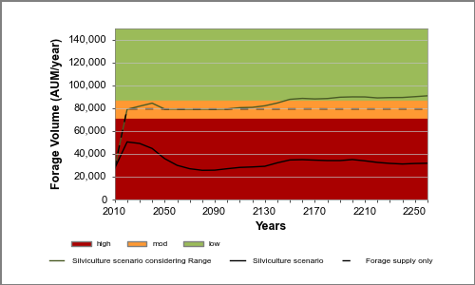
Forage Supply Comparison
Is it possible to achieve AUM forage targets across the land base and if so, what is the best way to implement this?
Notes:
The sum of all AUM targets on the Okanagan TSA is ~88,000 AUM per year.
Is it possible to achieve AUM forage targets across the land base and if so, what is the best way to implement this
This is easily achieved by a silviculture considering range and a forage supply only scenarios as shown.
This figure depicts a comparison of the forage supply achieved by each scenario against a risk-based backdrop (calculated as 10% on either side of the target i.e. low risk is defined 10% greater than the AUM target).
Both scenarios increase from an initial value of 27,000 AUMs to the achievable AUM target in the first modeled period.
In comparison, the silviculture scenario that does not implement range cut-blocks does not get near the AUM target.

Slide 53
Range Cutblocks by Scenario
Scenario | Conventional Harvest (cc/pc) | Range cut-block type 1/2 | Range cut-block type 3 | Range cut-block type 4
Silviculture scenario | 10,545 | 0 | 0 | 0
Silviculture considering range | 9,298 | 521 | 108 | 426
Forage supply only | 1,342 | 1,028 | 721 | 623
Notes:
As seen in the silviculture considering range scenario, only a small change in management (cutblock types) is needed to fulfil the forage targets.
also, there was an important trend in type 3 and type 4 cut-blocks-
where possible, these cut-blocks were placed predominantly dry belt Douglas-fir stands
Conversion to range in some of these cases represents a win-win situation for these overlapping values.

Slide 54
Tree Species Deployment at the Landscape Level with consideration for Climate Change
BGC Zone | Desired Trend by Species |  |  |  |  |  |  |  | Comments
 | Pl | Sx | Fd | Lw | Cw | Hw | Pw | Py
ICHwk | ◊ | ↓ | ◊ | ◊ | ◊ |  | ◊ | n/a | Maintain the trends for Pl and Fd, may wish to limit Sx use - monitor. Maintain present trends, note the use of Pw and replacement of Cw.
IDFmw | ↓ | ◊ | ↑ | ◊ | ◊ | n/a | n/a | ◊ | Reduce level of Pl use below harvest proportion. Maintain trend for Sx, promote Fd. Maintain present trend of increased use of Lw and reduced use of Cw. Promote Py where suited.
MSdm | ◊ | ◊ | ↑ | n/a | n/a | n/a | n/a | n/a | Maintain trends for Pl and Sx, but do not increase Sx above the present proportion used. Promote use of Fd where suited. Use Lw where suited in a limited capacity.
IDFdk | ↓ | ↓ | ↑ | ↓ | n/a | n/a | n/a | ↑ | Reduce reliance on Pl except on sites unsuitable for other species. Avoid planting Sx on zonal sites due to increased drought potential. Promote the use of Fd. Decrease or do not increase use of Lw, promote Py where suited.
Richmond BC
Notes:
Another strategy that will be considered when implementing the silviculture strategy is climate change adaptation.
Forest management opportunities currently exist to adapt to climate change if we view the decisions through a ‘climate change lens’.
As part of the Type 4 process, a workshop to provide landscape level guidance for strategic species deployment is held in each TSA
This direction is regarded as the first step in an iterative and ongoing process refining species deployment at the landscape level.
a summary of the species deployment direction from each workshop is shown in a table, where the desired trend for each species by BEC subzone is indicated by
“◊” = maintain the proportion planted to logged;
“↓” = Decrease the current proportion planted to logged; and
“↑” = Increase the current proportion planted to logged.

Slide 55
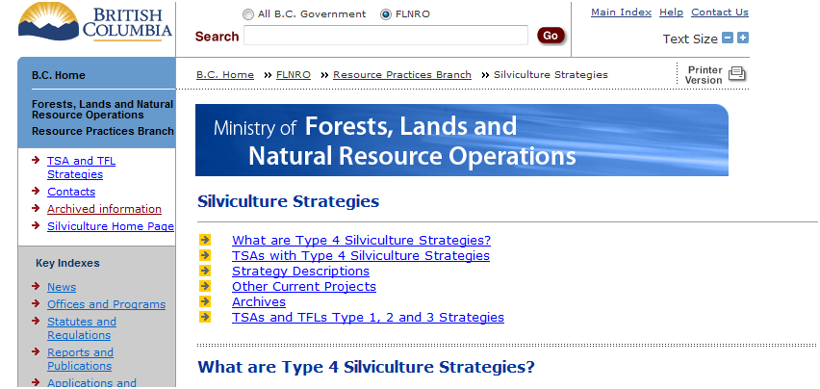
Type 4 Website
http://www.for.gov.bc.ca/hfp/silstrat/index.htm
Notes:
All of the Type 4 deliverables are being posted on the RPB website, along with all of the previous silv strategies and other related documentation

Slide 56
Thank you
District Champions
Agathe Bernard, Carolyn Stevens – Lakes & Morice
Brad Powell – Quesnel
Ted McRae, Katherine Ladyman – Okanagan
Bill Olsen, Doug McArthur – 100 Mile House
John Pousette, Alena Charlston , Cathy Middlteon, Andrew Tait– Prince George
Kerri Howse, Mark Hamm - Williams Lake
Licensees
BC Timber Sales
RPB
  Ralph Winter
  Matt Leroy
  Al Powelson
Regional and Headquarters Staff
FLNRO Regional Operations staff – Ecology, Forest Health, Range, Habitat
Forest Analysis & Inventory Branch – TSR Analysts
Wildfire Management Branch - Fire Mgt Specialists
Contractors
Ecora – Kelly Sherman, Krysta Giles-Hansen
FESL - Antti Makitalo, Jeff McWilliams
Symmetree - Bryce Bancroft
Forsite - Cam Brown, Pat Bryant
Richmond BC
Notes:
Finally I would like to thanks all of the district champions, some of you are here today,
And all the other district, licensee, BCTS staff, and contractors who are involved and helping with this process.
This s really only a partial list.

